Slide 1
Enabling Secure, NB-IoT End Nodes with MCUXpresso Enablement and PSA-Certified MCUs to Address the Growing Industrial IoT market
Tomas Voda
NXP Systems engineer
Imad Mikaiel
Sequans Communications, Product Marketing Director
March 2020

Slide 2
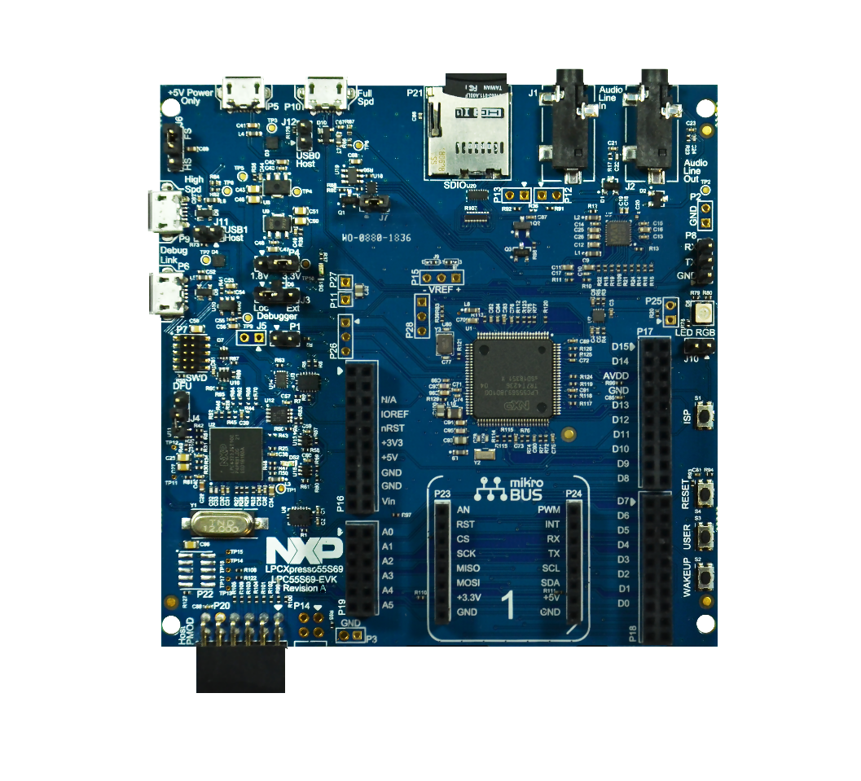
Board Giveaway
LPC55S69-EVK Evaluation Kit
Attendees of this session are eligible to receive one of 40 complimentary LPC55S69-EVK evaluation kits.
Contest Details: Entrants must attend the webinar and be at least 18 years of age or of legal age in local jurisdiction as of March 1, 2020 to be eligible. NXP is responsible for the collection, submission and/or processing of the overall administration of this webinar. NXP is responsible for the administration of the giveaway. Entrants should contact NXP with any questions or comments related to this giveaway. Winners will be randomly selected and notified by the email address provided in the webinar registration by March 31,2020. Any winner notification not responded to or returned as undeliverable may result in prize forfeiture, and a new winner will be selected and then notified in the same manner as mentioned above. No purchase necessary to win. Void where prohibited.

Slide 3




Cellular Connectivity
NB-IoT + LTE-M
LPC5500 MCU

Slide 4

LPC5500 MCU Series
Single and dual-core Arm® Cortex®-M33 based MCU
Ultra-efficient 40-nm flash technology:
  Over 1150 CoreMarks and as low as 32uA/MHz2
  DSP accelerator
  Cryptography accelerators
  Enhanced safety and security
  Scalable memory and package size
  System Integration for Industrial and IoT Markets
    High-Precision ADCs
    CAN-FD for industrial control
    HS USB with On-Chip PHY
    HS SPI, SDIO, FlexComms (UART, I2C, I2S,SPI)
MCUXpresso developer ecosystem
Longevity extended to 15 years
Notes:
Accessible Security
TrustZone-M for asset protection
Secure boot and SRAM PUF based key storage for root of trust and provisioning
Execution from encrypted images (internal flash)
Breakthrough Performance Efficiency
Integrated power management unit with buck DC-DC
Dedicated co-processors for signal processing & cryptographic acceleration
Scalable MCU Offering
First of many within our next generation LPC5500 MCU Series
Scalable package and memory options
Low-cost development board with expansion options
Robust enablement including MCUXpresso Software/Tools ecosystem

Slide 5


LPC5500 MCU Series Overview
 | LPC551x/S1x | LPC552x/S2x | LPC55S6x
Cortex-M33 #0 | Up to 150MHz | Up to 150MHz | Up to 150MHz
Cortex-M33 #1 | - | - | Yes (Up to 150MHz)
Accelerators/ Co-proccessors | Crypto Accelerator | Crypto Accelerator | PowerQuad DSP, Crypto Accelerator
Flash | Up to 256 KB | Up to 512 KB | Up to 640 KB
SRAM | Up to 96KB | Up to 256 KB | Up to 320 KB
Security | TrustZone Secure boot Tamper protection Debug authentication PRINCE TRNG, SHA-2, AES-256, PFR Code watchdog | Secure boot Tamper protection Debug authentication PRINCE TRNG, SHA-2, AES-256, PFR | TrustZone Secure boot Tamper protection Debug authentication PRINCE TRNG, SHA-2, AES-256, PFR
CoreMarks | 600 | 600 | 1150+ (Dual-core)
Serial Interfaces | Up to 9 FlexComm supporting USART, SPI, I2C and I2S. 1x HS LSPI | Up to 9 FlexComm supporting USART, SPI, I2C and I2S. 1x HS LSPI | Up to 9 FlexComm supporting USART, SPI, I2C and I2S. 1x HS LSPI
USB | USB FS w/PHY, USB HS w/PHY | USB FS w/PHY, USB HS w/PHY | USB FS w/PHY, USB HS w/PHY
SDIO | - | SDIO/SD/MMC | SDIO/SD/MMC
CAN | CAN FD/CAN 2.0 | - | -
ADC | 16b 2 Msps | 16b 1 Msps | 16b 1 Msps
GPIO | Up to 64 | Up to 64 | Up to 64
Active Power Consumption | 32uA/MHz | 32uA/MHz | 32uA/MHz
Packages | HTQFP64, HLQFP100, VFBGA98 | HTQFP64, HLQFP100, VFBGA98 | HTQFP64, HLQFP100, VFBGA98
NXP.COM/LPC5500

Slide 6
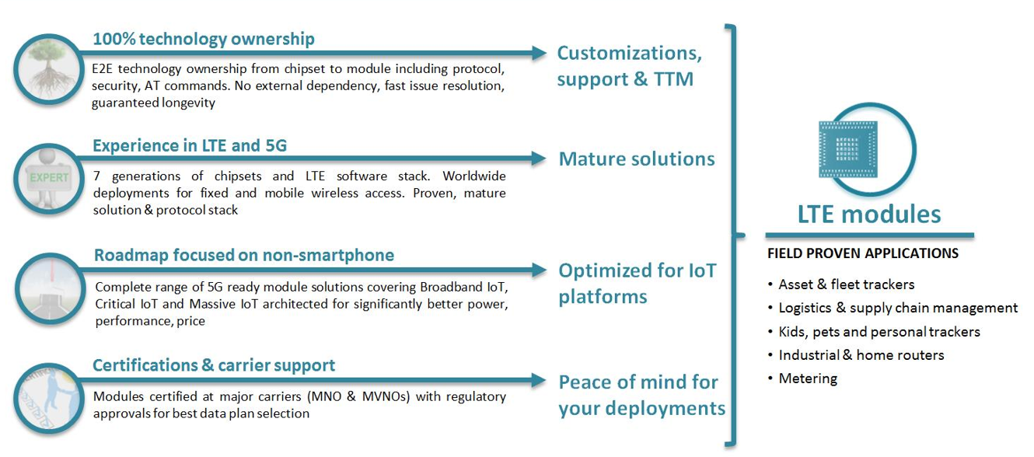
Sequans value proposal for broadband, critical and massive iot application

Slide 7
Introduction to connectivity
Overview of popular wireless connectivity

Slide 8
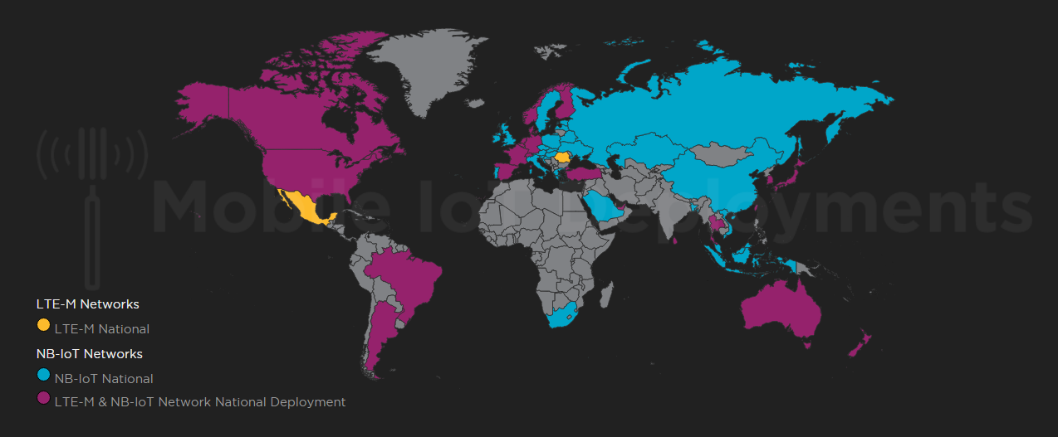

Internet of Things: LTE-M and NB-IOT Deployment Map

Slide 9
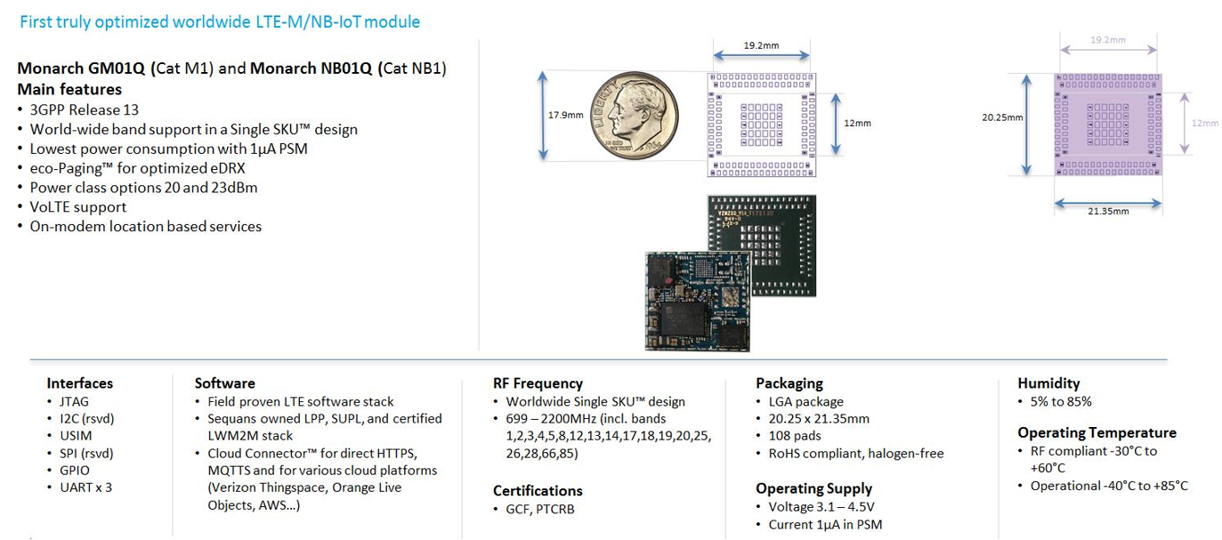
Monarch-based GM01Q / NB01Q
Cat M1 / Cat NB1
Monarch based GM01Q/NB01Q
CAT-M1 / Cat NB1

Slide 10

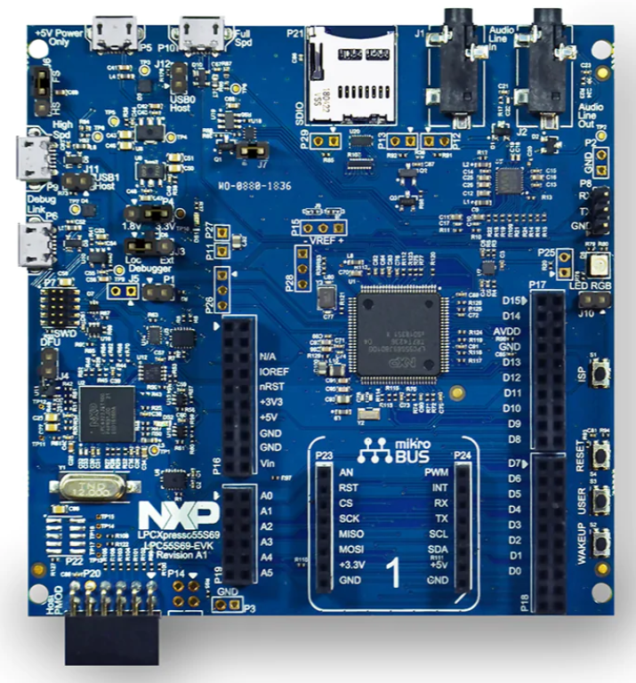
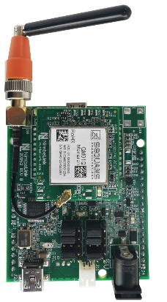

Monarch GM01Q-NXP
Providing cellular connectivity to NXP LPCXpresso55S69 Board
Born from a tight partnership between Sequans and NXP
Connected LPCXpresso55S69 development platform
  The Monarch GM01Q-NXP companion board from Sequans provides cellular connectivity solution to LPCXpresso55S69 MCU board
  Monarch GM01Q-NXP companion board fits into LPCXpresso55S69 through the Arduino bus, and exposes the existing mikro-BUS connector.
  Monarch GM01Q-NXP board is pre-integrated into LPCXpresso55S69 software suite, which provides a turnkey solution for connecting NXP products to any cloud server like AWS, GCP, Azure, etc. Cellular driver and Examples for NXP based CPU are available
  The kit can be shipped with a worldwide Truphone MVNO SIM card –refer to Truphone coverage-
  Two Monarch GM01Q-NXP SKUs exist for Cat-M1 and NB-IoT
Monarch
GM01Q-NXP
LPCXpresso55S69
Key Features
  Sequans GM01Q LTE Module
  Worldwide LTE-M or to NB-IoT support
  Designed for LPCXpresso55S69
  Debug connector for modem upgrade and console
  High-performance antenna for frequency ranges: 700MHz—2100MHz
  Free drivers and code examples available
Deliverables
  Board documentation
  Software updates

Slide 11
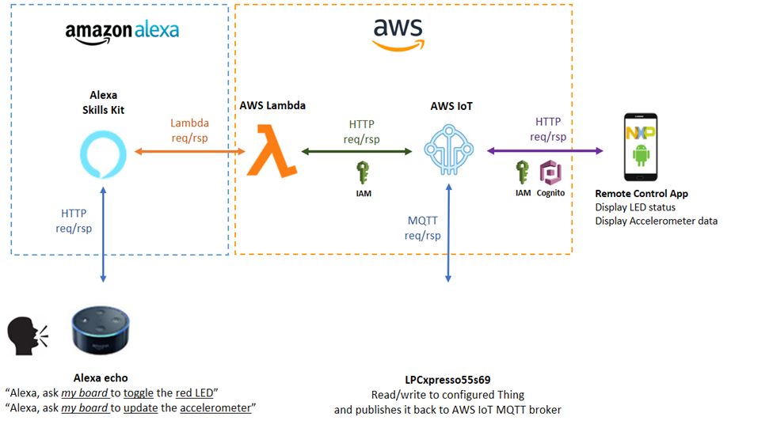
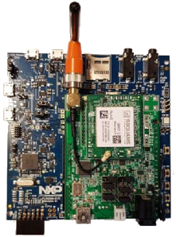
DEMO Overview
Cat-M/ NB-IoT

Slide 12
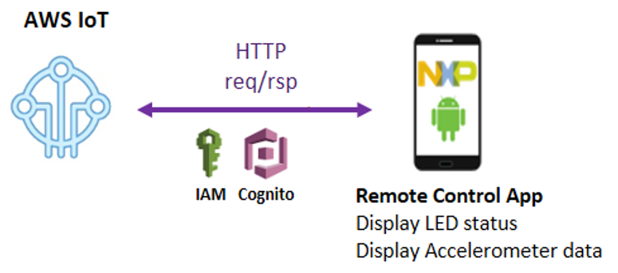

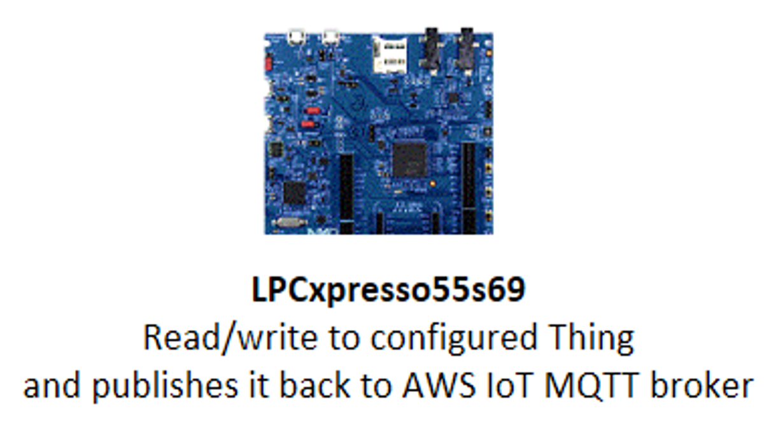
DEMO Overview – case 1
AWS cloud
Cellular connection
  NB IoT / LTE-M
  Private key in module
End device
  LPC5500 (GPIO,I2C, UART,..)
TLS
MQTT
GM01Q
NB01Q
UART

Slide 13
DEMO Overview – case 2
AWS cloud
Cellular connection
  NB IoT / LTE-M
End device
  LPC5500 (GPIO,I2C, UART,..)
  Private key in LPC5500
End to end security
  MbedTLS
  PUF
  Encrypted data from chip to cloud
TCP/IP
TLS
MQTT
GM01Q
NB01Q
UART

Slide 14




Additional Resources
Visit Sequans Online
https://www.sequans.com/
NXP Community Technical Support
https://community.nxp.com/welcome
Visit Sequans Modules
https://www.sequans.com/products-solutions/modules/
Visit NXP MCUs Online
www.NXP.com/MCU
Visit Sequans Development Platforms
https://www.sequans.com/products-solutions/development-platforms/
Visit LPC5500 MCU Series
www.NXP.com/LPC5500

Slide 15
Board Giveaway
LPC55S69-EVK Evaluation Kit
Attendees of this session are eligible to receive one of 40 complimentary LPC55S69-EVK evaluation kits.
Contest Details: Entrants must attend the webinar and be at least 18 years of age or of legal age in local jurisdiction as of March 1, 2020 to be eligible. NXP is responsible for the collection, submission and/or processing of the overall administration of this webinar. NXP is responsible for the administration of the giveaway. Entrants should contact NXP with any questions or comments related to this giveaway. Winners will be randomly selected and notified by the email address provided in the webinar registration by March 31,2020. Any winner notification not responded to or returned as undeliverable may result in prize forfeiture, and a new winner will be selected and then notified in the same manner as mentioned above. No purchase necessary to win. Void where prohibited.

